Slide 1
P1 Chapter 2: Quadratics Modelling With Quadratics

Slide 2
Modelling
The A Level has a particular emphasis of the application of theory to real-life situations. A mathematical model is the maths used to model such a situation, possibly with some simplifying assumptions.
Example (from textbook): A spear is thrown over level ground from the top of a tower.
The height, in metres, of the spear above the ground after $t$ seconds is modelled by the function: $h\left(t\right)=12.25+14.7t−4.9t^{2}, t≥0$
Interpret the meaning of the constant term 12.25 in the model.
After how many seconds does the spear hit the ground?
Write $h(t)$ in the form $A−B{\left(t−C\right)}^{2}$, where $A, B$ and $C$ are constants to be found.
Using your answer to part c or otherwise, find the maximum height of the spear above the ground, and the time at which this maximum height is reached?
When the time is 0, clearly $h\left(0\right)=12.25$. So the 12.25m is the height of the tower. (In general, the constant term of an expression is often the ‘initial value’.
When it hits the ground, $h\left(t\right)=0$, thus: $12.25+14.7t−4.9t^{2}$
Solving gives $t=−0.679 or t=3.68$ (to 3sf) but as $t≥0$, $t=3.68$ (to 3sf)
By completing the square: $23.275−4.9{\left(t−1.5\right)}^{2}$
The maximum height of the spear is 23.275m, 1.5 seconds after spear is thrown.
a
?
b
?
c
?
d
?

Slide 3
Modelling
The A Level has a particular emphasis of the application of theory to real-life situations. A mathematical model is the maths used to model such a situation, possibly with some simplifying assumptions.
Example (from textbook): A spear is thrown over level ground from the top of a tower.
The height, in metres, of the spear above the ground after $t$ seconds is modelled by the function: $h\left(t\right)=12.25+14.7t−4.9t^{2}, t≥0$
Interpret the meaning of the constant term 12.25 in the model.
After how many seconds does the spear hit the ground?
Write $h(t)$ in the form $A−B{\left(t−C\right)}^{2}$, where $A, B$ and $C$ are constants to be found.
Using your answer to part c or otherwise, find the maximum height of the spear above the ground, and the time at which this maximum height is reached?
a
When the time is 0, clearly $h\left(0\right)=12.25$. So the 12.25m is the height of the tower. (In general, the constant term of an expression is often the ‘initial value’.
When it hits the ground, $h\left(t\right)=0$, thus: $12.25+14.7t−4.9t^{2}$
Solving gives $t=−0.679 or t=3.68$ (to 3sf) but as $t≥0$, $t=3.68$ (to 3sf)
By completing the square: $23.275−4.9{\left(t−1.5\right)}^{2}$
The maximum height of the spear is 23.275m, 1.5 seconds after spear is thrown.
b
c
d

Slide 4
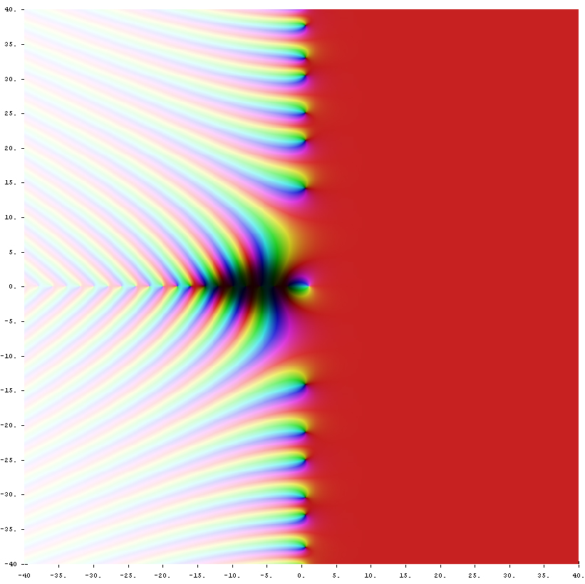
Would you like $1,000,000 for finding roots?
We saw earlier that the roots of a function $f$ are the values $x$ such that $f\left(x\right)=0$.
The Riemann Zeta Function is a function that allows you to do the infinite sum of powers of reciprocals, e.g.
$$ζ\left(2\right)=\frac{1}{1^{2}}+\frac{1}{2^{2}}+\frac{1}{3^{2}}+… \\ ζ\left(3\right)=\frac{1}{1^{3}}+\frac{1}{2^{3}}+\frac{1}{3^{3}}+…$$
One of the 8 ‘Clay Millennium Problems’ (for which solving any attracts a $1,000,000 prize) is to showing all roots of this function have some particular form, i.e. the form of $x$ such that $ζ\left(x\right)=0$.

Slide 5
Exercise 2.6
Pearson Pure Mathematics Year 1/AS
Page 11

Slide 6
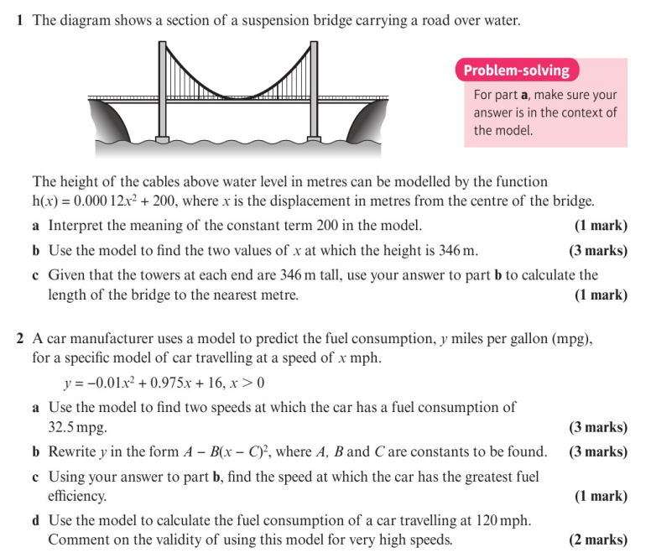
Homework Exercise

Slide 7
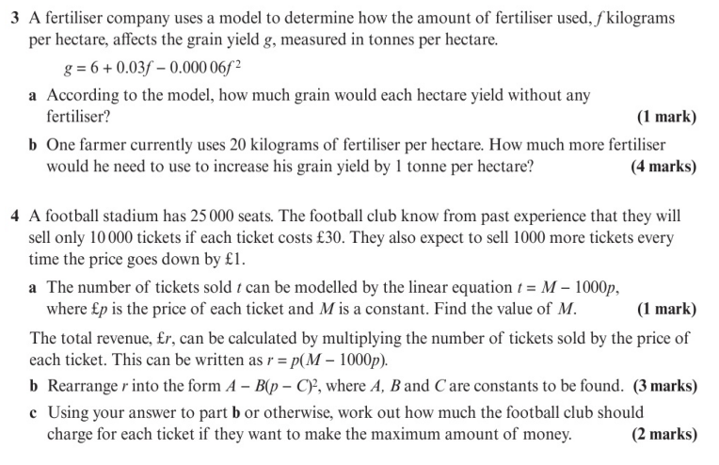
Homework Exercise

Slide 8
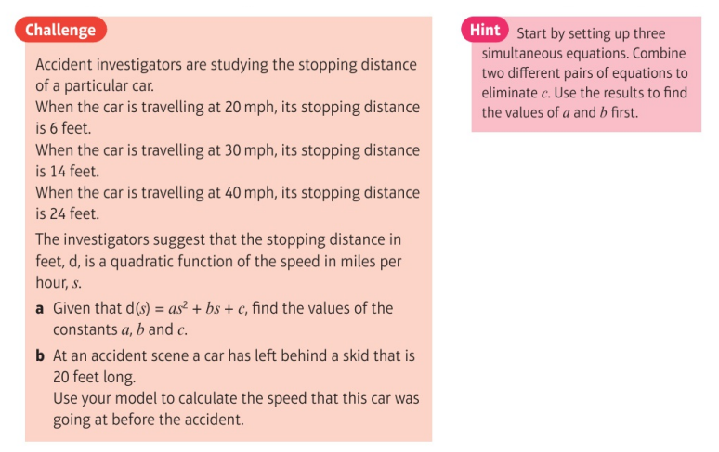
Homework Exercise

Slide 9
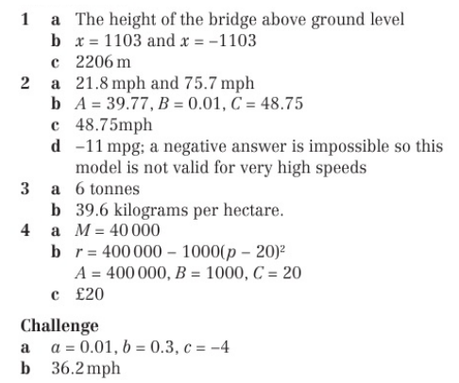
Homework Answers

